Slide 1
Object Oriented Programming in JAVA
(Practical#15)

Slide 2
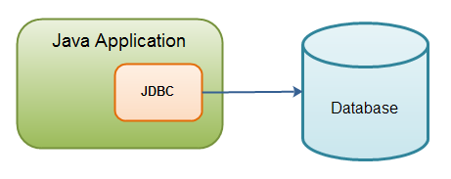
Objective: To become familiar with JDBC (Java Database Connectivity)
JDBC stands for Java Database Connectivity, which is a standard Java API for database connectivity between the Java programming language and a wide range of databases.
The Java JDBC API enables Java applications to connect to relational databases like MySQL, PostgreSQL, MS SQL Server, Oracle, H2 Database etc.
JDBC is a Java API that can access any kind of tabular data, especially data stored in a Relational Database.
JDBC Contains a set of classes and interface the allows the developer to establish a connection to a database.
JDBC is a Java API to connect and execute the query with the database.

Slide 3
Database defined
A database is an organized collection of data.
A database is an organized collection of structured information, or data, typically stored electronically in a computer system.
What is a Relational Database?
A relational database organizes data into tables which can be linked—or related—based on data common to each.
Relational databases maintain data in tables, providing an efficient and flexible way to store and access structured information.
Tables, also known as relations, consist of columns containing one or more data categories, and
rows, also known as table records, containing a set of data defined by the category

Slide 4
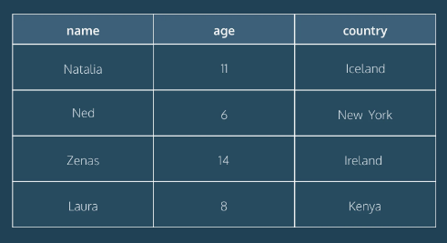
data in a relational database is organized into tables.
Columns are labeled with a descriptive name (say, age for example) and have a specific data type.
For example, a column called age may have a type of INTEGER.
The table also has four rows, or records, in it (one each for Natalia, Ned, Zenas, and Laura).

Slide 5
What is a Relational Database Management System (RDBMS)?
A relational database management system (RDBMS) is a Software / program that allows you to create, update, and administer a relational database.
(RDBMS) is a software that is used to define, create and maintain a database and provides controlled access to the data.
A Relational database is usually controlled by a Relational Database management system (RDBMS)
Together, the data and the RDBMS, along with the applications that are associated with them, are referred to as a database system.

Slide 6
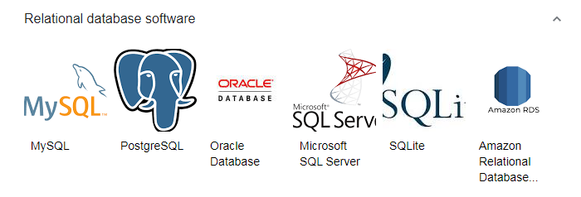

Slide 7
What is SQL?
SQL (Structured Query Language) is a programming language used to communicate with data stored in a relational database.
Most relational database management systems use the SQL language to access the database.
SQL syntax is similar to the English language, which makes it relatively easy to write, read, and interpret.
Many RDBMSs use SQL (and variations of SQL) to access the data in tables.
(SQL is often pronounced in one of two ways.
You can pronounce it by speaking each letter individually like “S-Q-L”, or pronounce it using the word “sequel”.)
You can communicate with relational databases using Structured Query Language (SQL), the standard language for interacting with data stored relational database.
.

Slide 8
Types of Databases
There are many different types of databases. The best database for a specific organization depends on how the organization intends to use the data.
Relational databases. Relational databases became dominant in the 1980s. Items in a relational database are organized as a set of tables with columns and rows. Relational database technology provides the most efficient and flexible way to access structured information.
Object-oriented databases. Information in an object-oriented database is represented in the form of objects, as in object-oriented programming.
Distributed databases. A distributed database consists of two or more files located in different sites. The database may be stored on multiple computers, located in the same physical location, or scattered over different networks.
Data warehouses. A central repository for data, a data warehouse is a type of database specifically designed for fast query and analysis.
NoSQL databases. A NoSQL, or nonrelational database, allows unstructured and semistructured data to be stored and manipulated (in contrast to a relational database, which defines how all data inserted into the database must be composed). NoSQL databases grew popular as web applications became more common and more complex.
Graph databases. A graph database stores data in terms of entities and the relationships between entities.
OLTP databases. An OLTP database is a speedy, analytic database designed for large numbers of transactions performed by multiple users.

Slide 9
The JDBC library includes APIs for each of the tasks mentioned below that are commonly
associated with database usage.
Making a connection to a database.
Creating SQL statements.
Executing SQL queries in the database.
Viewing & Modifying the resulting records.

Slide 10
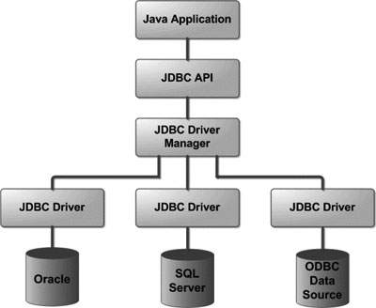
JDBC API uses JDBC drivers to connect with the database.
JDBC Driver is a software component that enables java application to interact with the database.
Following is the architectural diagram, which shows the location of the driver manager with respect to the JDBC drivers and the Java application

Slide 11
JDBC with MYSQL
Pre-Requisite
Before moving further, you need to have a good understanding of the following two subjects −
Core JAVA Programming
MySQL Database
Install Java
Install J2SE Development Kit 5.0 (JDK 5.0) from Java Official Site. https://www.oracle.com/java/technologies/javase-downloads.html
Make sure following environment variables are set as described below −
JAVA_HOME: This environment variable should point to the directory where you installed the JDK, e.g. C:\Program Files\Java\jdk1.5.0.
CLASSPATH: This environment variable should have appropriate paths set, e.g. C:\Program Files\Java\jdk1.5.0_20\jre\lib.
PATH: This environment variable should point to appropriate JRE bin, e.g. C:\Program Files\Java\jre1.5.0_20\bin.

Slide 12
Install MySQL Database
https://www.tutorialspoint.com/jdbc/jdbc-environment-setup.htm
https://www3.ntu.edu.sg/home/ehchua/programming/sql/MySQL_HowTo.html
MySQL DB: MySQL is an open source database. You can download it from MySQL Official Site. Download full windows installation ( Recommended ) https://dev.mysql.com/downloads/
https://dev.mysql.com/downloads/installer/
In addition, download and install MySQL Administrator as well as MySQL Query Browser. These are GUI based tools that will make your development much easier.

Slide 13
JDBC API uses JDBC drivers to connect with the database.
MySQL Connector/J is the official JDBC driver for MySQL
Download “mysql-connector-java-5.1.24.zip” from below link and extract it anywhere in your computer.
http://dev.mysql.com/downloads/connector/j/ or http://ge.tt/4QETwMf (Direct download extracted jar file).
Finally, unzip MySQL Connector/J (the MySQL JDBC driver) in a convenient directory. For the purpose of this tutorial we will assume that you have installed the driver at C:\Program Files\MySQL\mysql-connector-java-5.1.8.
In order for Java applications working with a database engine via (JDBC), an appropriate JDBC driver library is required to be available in the application’s classpath. A JDBC driver library consists of Java classes which implement low-level communication with the database engine.
It talks with Java applications via JDBC API and usually bundled as a JAR or ZIP file.

Slide 14
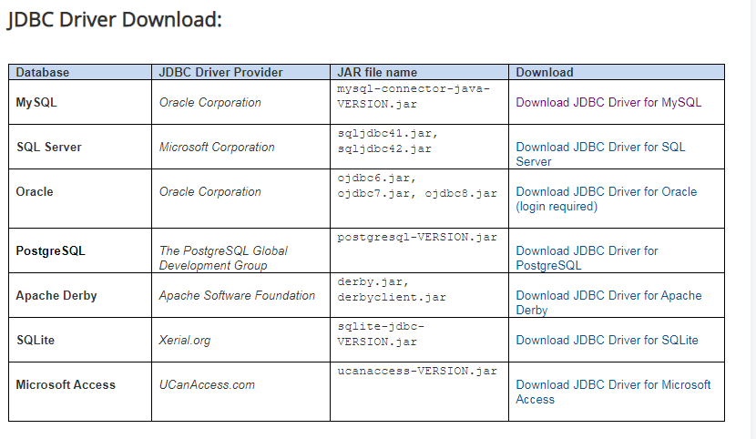
In the table below, click on the download link corresponding to the database you want to download its JDBC driver JAR file:

Slide 15
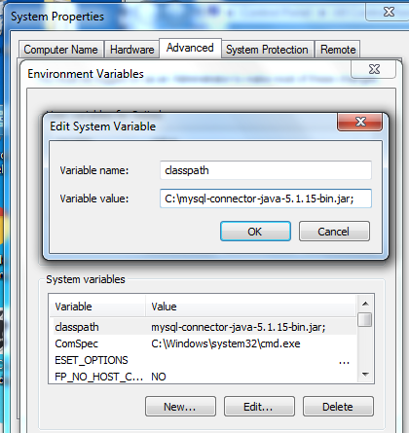
After downloading driver u will get . zip. Extract it and copy only the mysql-connector-java-5.1.15-bin.jar
file into C:\Program Files\Java\jre7\lib\ext folder.
set CLASSPATH to your “mysql-connector-java-5.1.24-bin.jar” file

Slide 16
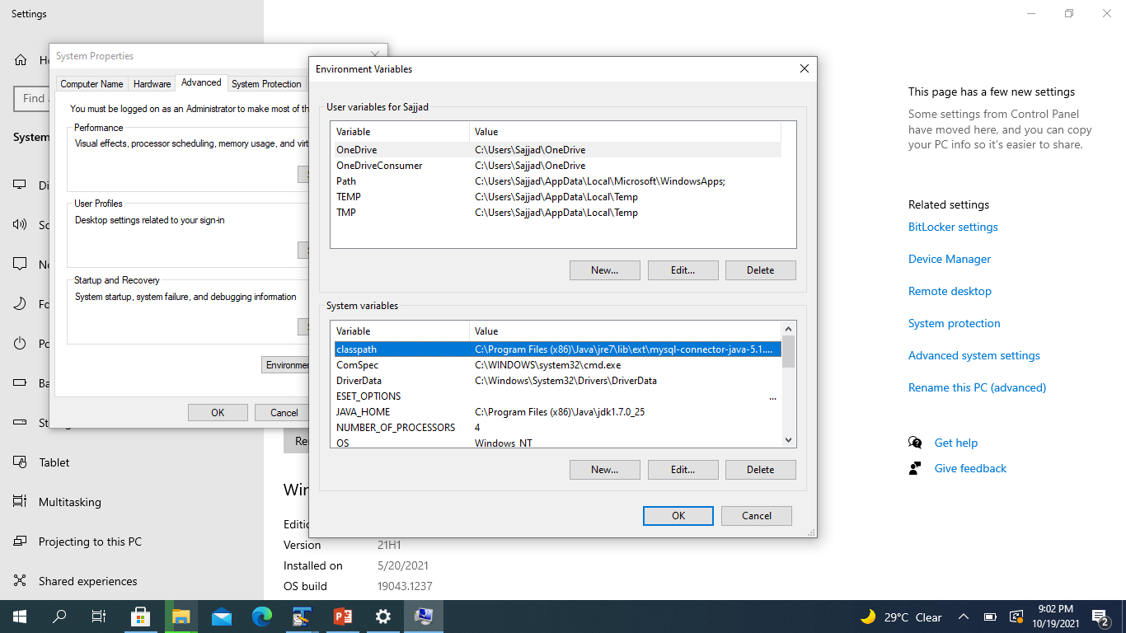

Slide 17
The java.sql package contains classes and interfaces for JDBC API.
A list of popular interfaces of JDBC API are given below:
Driver interface
Connection interface
Statement interface
PreparedStatement interface
CallableStatement interface
ResultSet interface
ResultSetMetaData interface
DatabaseMetaData interface
RowSet interface
A list of popular classes of JDBC API are given below:
DriverManager class
Blob class
Clob class
Types class

Slide 18
Creating JDBC Application
There are following six steps involved in building a JDBC application −
Import the packages: Requires that you include the packages containing the JDBC classes needed for database programming. Most often, using import java.sql.* will suffice.
Register the JDBC driver: Requires that you initialize a driver so you can open a communication channel with the database.
Open a connection: Requires using the DriverManager.getConnection() method to create a Connection object, which represents a physical connection with the database.
Execute a query: Requires using an object of type Statement for building and submitting an SQL statement to the database.
Extract data from result set: Requires that you use the appropriate ResultSet.getXXX() method to retrieve the data from the result set.
Clean up the environment: Requires explicitly closing all database resources versus relying on the JVM's garbage collection.

Slide 19
Steps to connect to the database in java
Import JDBC Packages
import java.sql.* ; // for standard JDBC programs
Register the driver class
Creating connection
Creating statement
Executing queries
Closing connection

Slide 20
1) Register the driver class
You must register the driver in your program before you use it. Registering the driver is the process by which the MySQl driver's class file is loaded into the memory, so it can be utilized as an implementation of the JDBC interfaces.
Driver class: The driver class for the mysql database is com.mysql.jdbc.Driver.
The forName() method of Class class is used to register the driver class. This method is used to dynamically load the driver class.
Syntax of forName() method
Example to register the MYSQLDriver class
Class.forName("oracle.jdbc.driver.OracleDriver");

Slide 21
2) Create the connection object
The getConnection() method of DriverManager class is used to establish connection with the database.
Syntax of getConnection() method
1) public static Connection getConnection(String url) throws SQLException
2) public static Connection getConnection(String url,String name,String passwor
throws SQLException
Connection URL: The connection URL for the mysql database is
jdbc:mysql://localhost:3306/software
where jdbc is the API, mysql is the database, localhost is the server name on which mysql is
running, we may also use IP address, 3306 is the port number and dbname is the database
name.

Slide 22
Steps to connect to the database in java
3) Create the Statement object
The createStatement() method of Connection interface is used to create statement. The object of statement is responsible to execute queries with the database.
Syntax of createStatement() method
public Statement createStatement()throws SQLException
Example to create the statement object
Statement stmt=con.createStatement();

Slide 23
Steps to connect to the database in java
4) Execute the query
The executeQuery() method of Statement interface is used to execute queries to the database. This method returns the object of ResultSet that can be used to get all the records of a table.
Syntax of executeQuery() method
public ResultSet executeQuery(String sql)throws SQLException
Example to execute query
ResultSet rs=stmt.executeQuery("select * from emp");
while(rs.next()){
System.out.println(rs.getInt(1)+" "+rs.getString(2));
}

Slide 24
Steps to connect to the database in java
5) Close the connection object
By closing connection object statement and ResultSet will be closed automatically. The close() method of Connection interface is used to close the connection.
Syntax of close() method
public void close()throws SQLException
Example to close connection
con.close();

Slide 25
JDBC ResultSet Interface
The SQL statements that read data from a database query, return the data in a result set. The java.sql.ResultSet interface represents the result set of a database query.
ResultSet Interface is present in the java.sql package. It is used to store the data which are returned from the database table after the execution of the SQL statements in the Java Program. The object of ResultSet maintains cursor point at the result data.
In default, the cursor positions before the first row of the result data.
The next() method is used to move the cursor to the next position in a forward direction. It will return FALSE if there are no more records.
It retrieves data by calling the executeQuery() method using any of the statement objects.
The object of ResultSet maintains a cursor pointing to a row of a table. Initially, cursor points to before the first row.

Slide 26
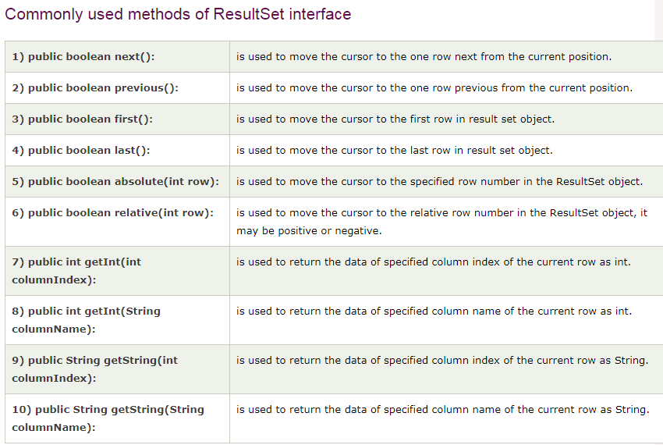

Slide 27
We cannot create any object for any interface. But it is possible to assign a class object which is implementing that interface to the reference variable of that interface.
Here connect is a reference variable to that interface, and DriverManager.getConnection() returns a class object which implements the Connection interface.

Slide 28
JDBC API uses jdbc drivers to connect with the database.

Slide 29
JDBC
JDBC Driver is a software component that enables java application to interact with the database.
There are 4 types of JDBC drivers:
JDBC-ODBC bridge driver
Native-API driver (partially java driver)
Network Protocol driver (fully java driver)
Thin driver (fully java driver)

Slide 30
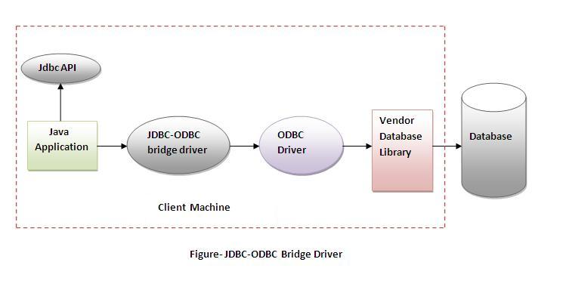
JDBC-ODBC bridge driver : uses ODBC driver to connect to the database. The JDBC-ODBC bridge driver converts JDBC method calls into the ODBC function calls. This is now discouraged because of thin driver.
Advantages:
easy to use.
can be easily connected to any database.
Disadvantages:
Performance degraded because JDBC method call is converted into the ODBC function calls.
The ODBC driver needs to be installed on the client machine.

Slide 31
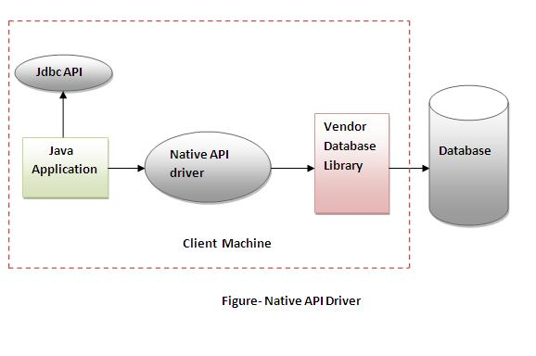
2) Native-API driver
The Native API driver uses the client-side libraries of the database. The driver converts JDBC method calls into native calls of the database API. It is not written entirely in java.
Advantage:
performance upgraded than JDBC-ODBC bridge driver.
Disadvantage:
The Native driver needs to be installed on the each client machine.
The Vendor client library needs to be installed on client machine.

Slide 32
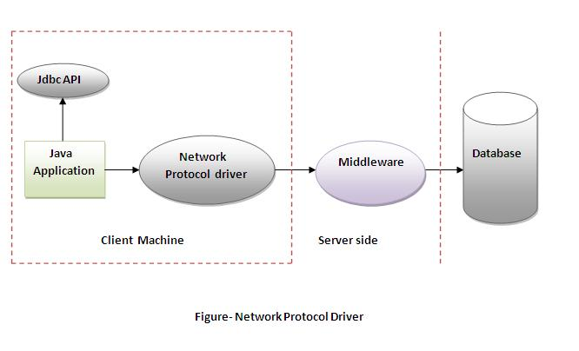
3) Network Protocol driver
The Network Protocol driver uses middleware (application server) that converts JDBC calls directly or indirectly into the vendor-specific database protocol. It is fully written in java.
Advantage:
No client side library is required because of application server that can perform many tasks like auditing, load balancing, logging etc.
Disadvantages:
Network support is required on client machine.
Requires database-specific coding to be done in the middle tier.
Maintenance of Network Protocol driver becomes costly because it requires database-specific coding to be done in the middle tier.

Slide 33
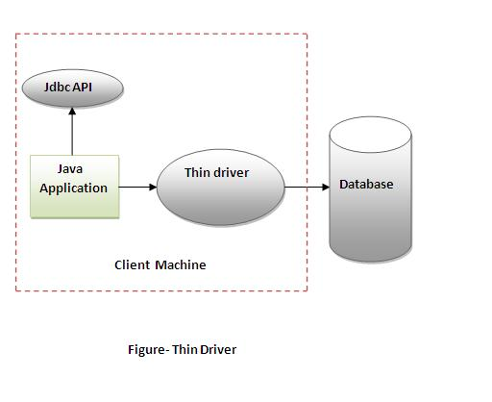
4) Thin driver
The thin driver converts JDBC calls directly into the vendor-specific database protocol. That is why it is known as thin driver. It is fully written in Java language.
Advantage:
Better performance than all other drivers.
No software is required at client side or server side.
Disadvantage:
Drivers depends on the Database

Slide 34
Tasks for Lab # 15
Task # 15:

